Slide 1
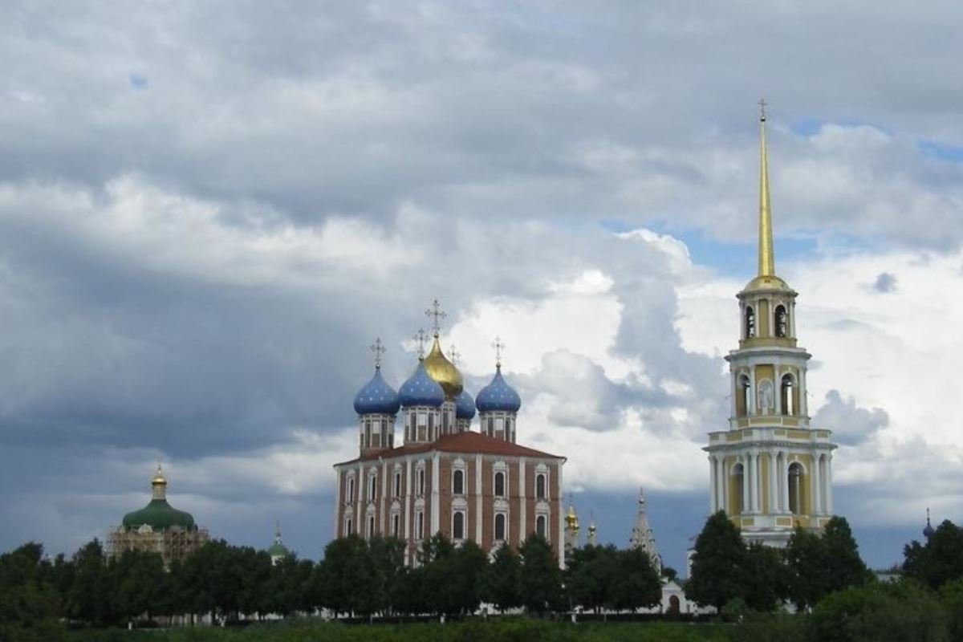
Ryazan

Slide 2
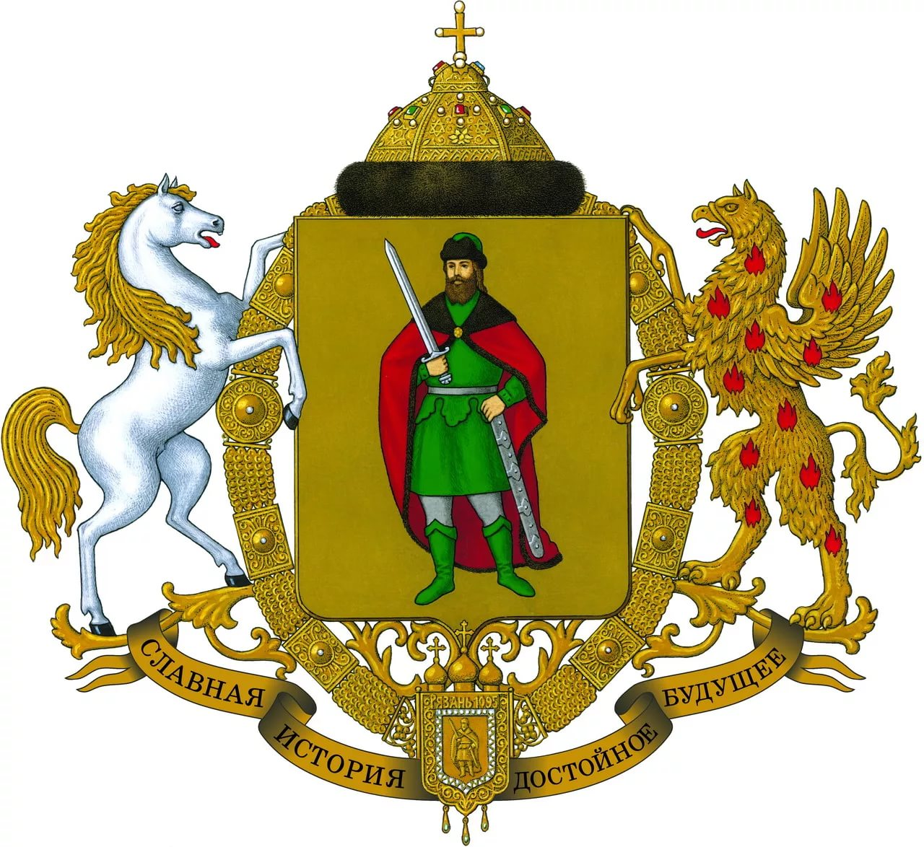

Slide 3
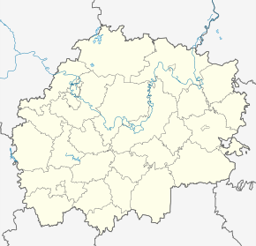
Ryazan is located in the center of the East European plain, between the Oka and Volga rivers in the Western part of the Ryazan region. The territory of the city is 224 square kilometers Population: 538 962 people
Geographical position
Рязань

Slide 4
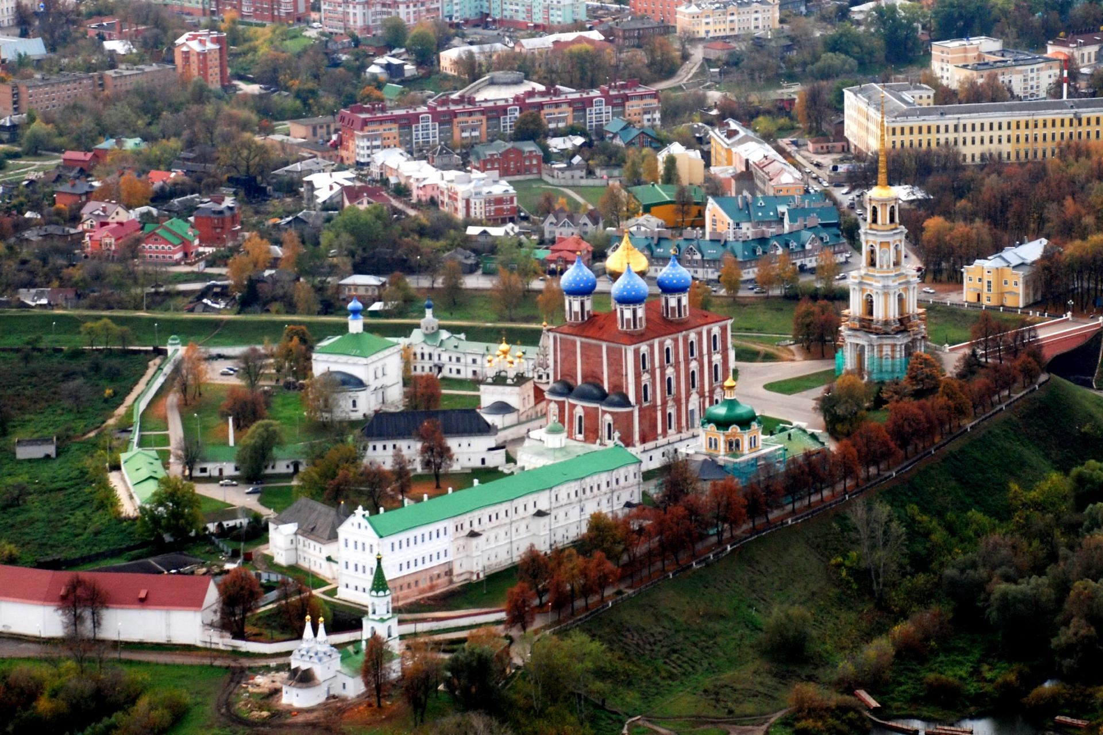
History
On may 8, 1904, Emperor Nicholas II visited the city.
In October 1918 the first higher educational institution — pedagogical Institute was opened in the city. In the same year, state art workshops were established, and a year later the land use and music school, which gave rise to modern construction and music colleges, was opened.

Slide 5
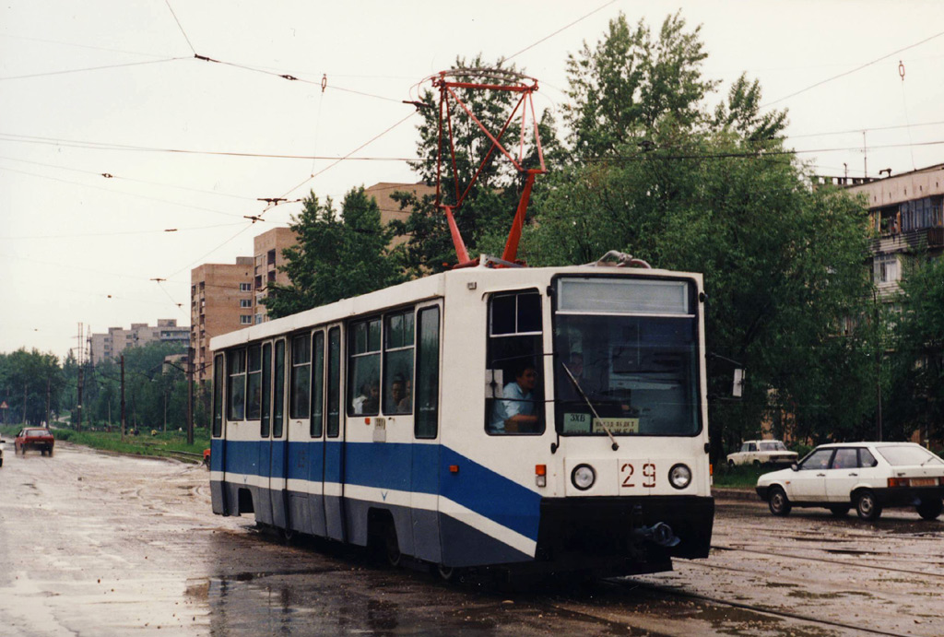
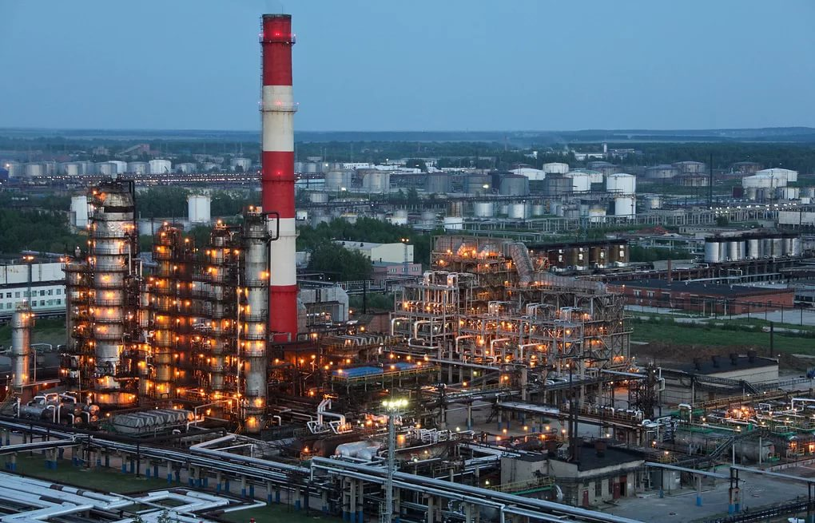
Economics
The city is located Ryazan oil refining company, which is engaged in the production of gasoline, diesel fuel, kerosene, fuel oil, bitumen and other petroleum products.
Currently, the city gives 60 % of the gross output of the region's industry. The presence of large universities and design offices in the city makes it possible to provide industrial personnel with a qualified workforce

Slide 6
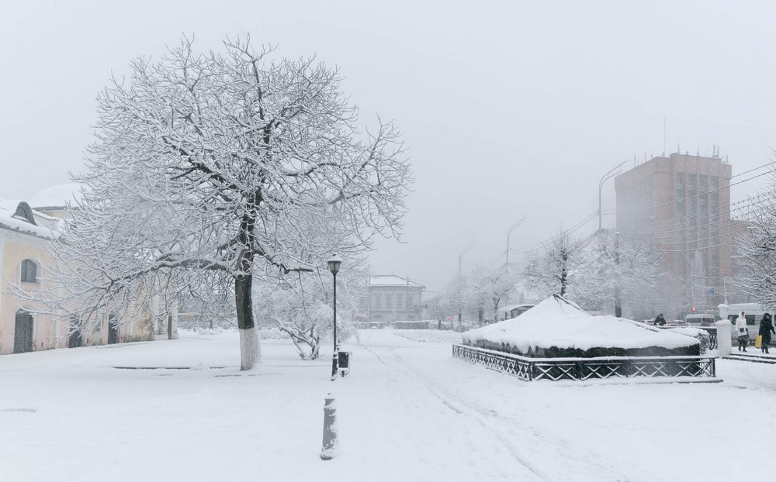
Climate
The climate of the city is moderately continental.
Summer in Ryazan warm, possible heat to almost + 40 in the shade. Winter is moderately cold, in some winters at night, the temperature can fall below -40 . Such significant deviations from the norm are possible when installing a blocking anticyclone, the air mass is quickly warmed or emasculated depending on the season.

Slide 7
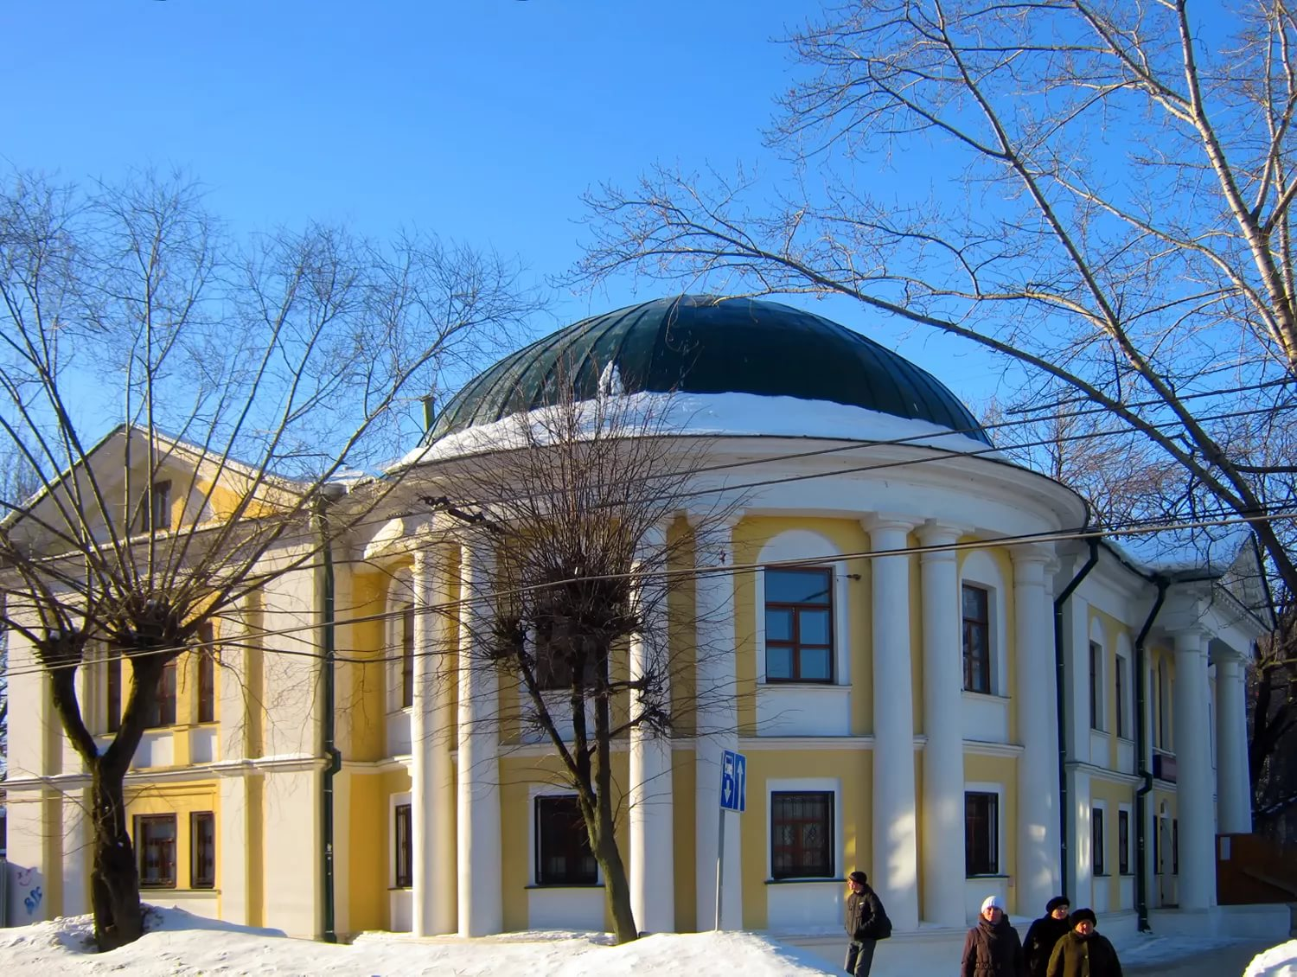
Sightseeing in Ryazan
Mal hospice

Slide 8
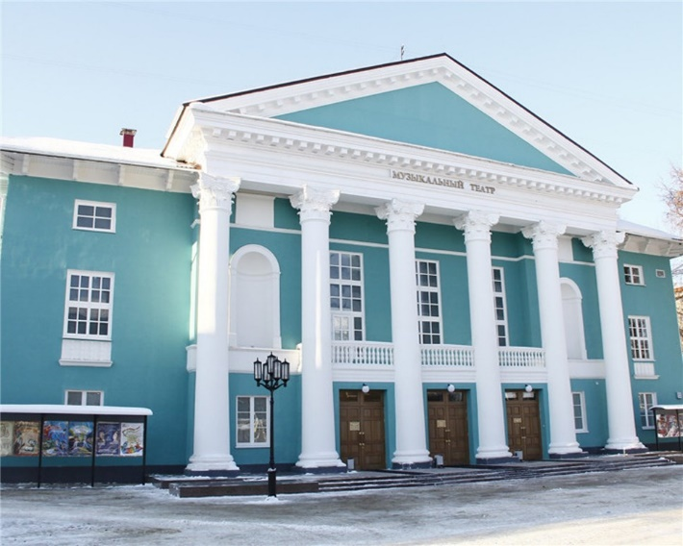
Ryazan regional music center

Slide 9
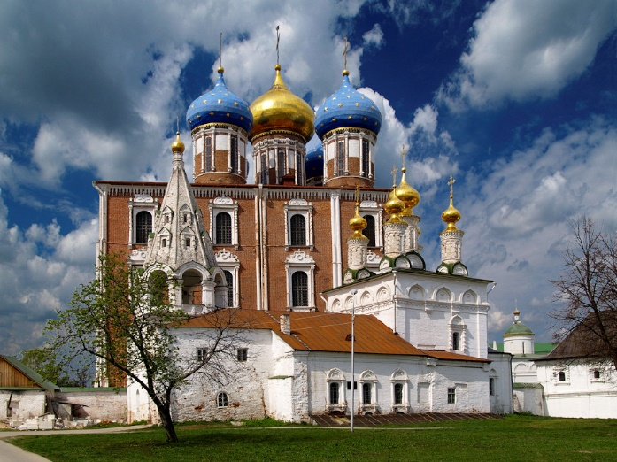
Uspensky cathedral

